Slide 1
CSCI 3003: Lab5 (Day 2)
3/07/2018

Slide 2
Agenda
Review Day 1
Part I; Part II
Finish Lab5
Part II (c, d, e, f)
Some pointers

Slide 3
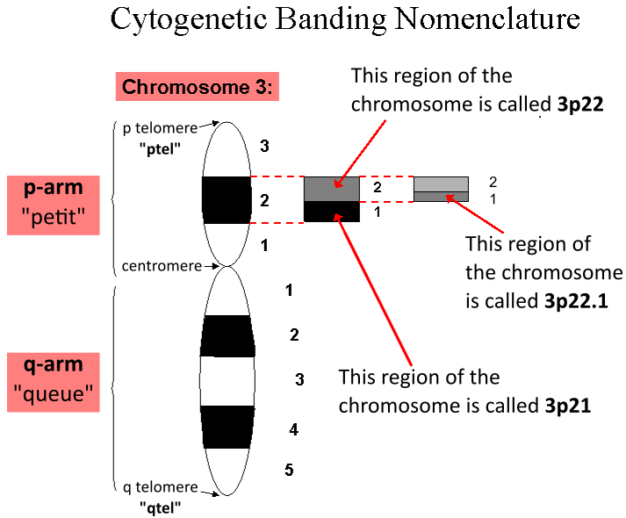
Review: Part I
(a) Write a function (is_valid_humanlocus) to check the validity of a string of this format:
<Chromosome num> p/q <region> <band> dot <sub-band>
<1 to 23 or X or Y> p/q <number> dot <number>
Return True (if valid) or False (if not)
‘3p22.1’ (valid) ‘3p22.1p’ (invalid)
Check assert(is_valid_humanlocus(‘3p22.1’))
(b) see if a human locus is encoded on the short arm (p) of a chromosome (Write another function by reusing the function from (a))

Slide 4
Review: Part II (a)
Analyze SNPs from two fictitious person (Greg and Lilly).
(a) One file for each of them. Format of the data:
rs3094315chr1-742429(A,A)
rs12562034chr1-758311(A,G)
Parse to:
Rs3094315 1 742429 A A
Rs12562034 1 758311 A G
How did some of you do that?

Slide 5
Review: Part II (b)
Once you’ve finished part (a), use your code to define a function called read_SNP_file, which you then call from your main script to process both Greg and Lilly’s data. The function should accept a string with the file name as an argument and return a data structure with all of the individual’s SNP information.
It can be done in many different ways. Any suggestions?
(Line 27 has been removed from the data. Greg and Lilly should have same number of lines now)

Slide 6
Part II (c)
On Chromosome 10, find the largest region of shared SNPs between Lilly and Greg. The answer will be in the form of a pair of genomic coordinates (Position1, Position2).
Both ways are acceptable:
Finding region of the maximum length (of shared SNPs)
(position2 - position1 + 1) is largest.
Finding region with maximum number of shared SNPs.

Slide 7
Part II (c)
Chromosome | Position | Greg | Lilly
10 | 31,000 | AA | AA
10 | 31,123 | TT | TT
10 | 31,200 | CC | CC
10 | 31,625 | AT | AA
10 | 31,630 | GG | GG
10 | 31,930 | TT | TT
10 | 32,000 | CG | GG
region of the maximum length: (31,630: 31,930)
Region of maximum shared SNPs (31,000: 31,200)

Slide 8
Part II (d)
The SNP_Definitions.txt file contains information about the effects of various SNPs. Load the SNP definitions into a data structure so that you can lookup a description given a SNP id and the bases.
Format: rs1048990 CC 1.48x risk
Separated by tabs (Hint: Split)
*** 3 lines for the same rsid:
rs1048990 CG 1.48x risk
rs1048990 GG common
You can use a function or not (your choice)

Slide 9
Part II (e)
Use the information you read in from SNP_Definitions.txt to identify what the region between 22070000 and 22106000 on chromosome 9 suggest about Greg’s chance of a heart attack. What about Lilly’s chance of a heart attack?
The region (position) and chromosome number is available from part (b) (we stored in a data structure).
Disease information is available from part (d) (3rd column of SNP_file)
*** Connection between both: rsid + bases
Not all of the rsid from Greg’s (or Lilly’s) file are inside SNP info file (HINT: remember to check if the key is present in dictionary; its generally a safer way anyway).

Slide 10
Part II (f)
Find a SNP locus that interests you at SNPedia.com. Describe what is known about the locus. Also, check what the SNP status is in both Lilly and Greg. What does the SNP suggest about their possible health?
Your’s truly: Internet

